Slide 1
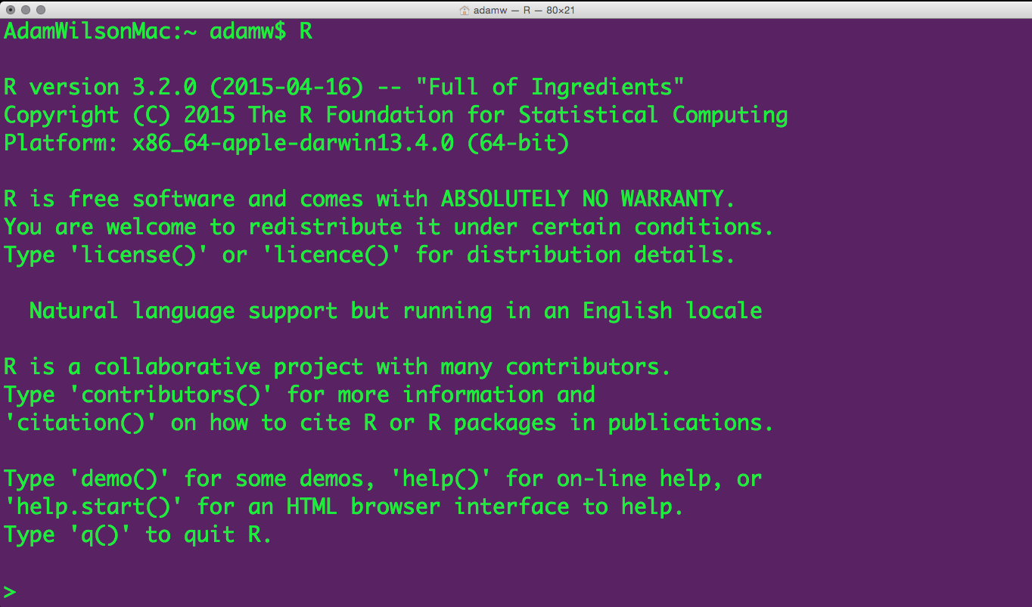
Spatial environmental data analysis with R GEO 503

Slide 2
Agenda
What is R?
Who uses it?
“Reproducible Research”
Guided interactive coding

Slide 3
Course Structure
Mondays 9:10-11:40 (2 hours 40 min)
Review/Questions
~30 Minute Presentation
Guided interactive exercises on your laptops

Slide 4
Course Objectives
3 Learning Objectives
Become familiar with R programming language
Learn to code geospatial analyses
Learn to develop custom data visualization (especially spatial)
Learn to develop reproducible research workflows
This course is NOT
A statistics course (see GEO 505, etc.).
We will focus on workflow and methods (‘how’ not ‘why’)

Slide 5
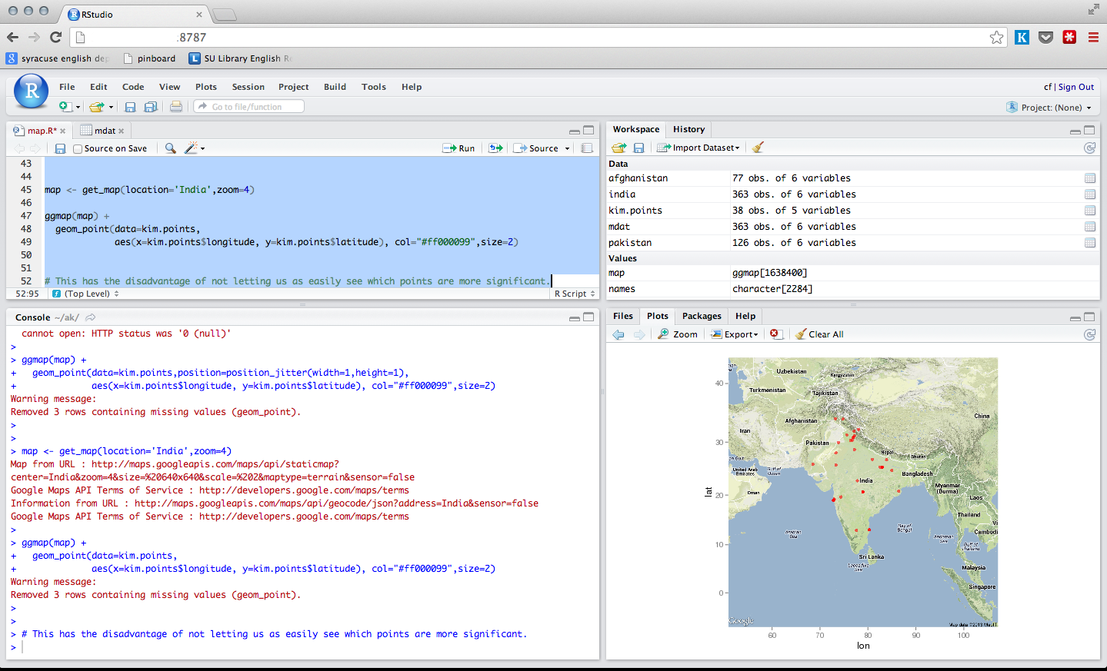
Workshop course
Most of our time will be spent thinking about, looking at, and writing code…

Slide 6
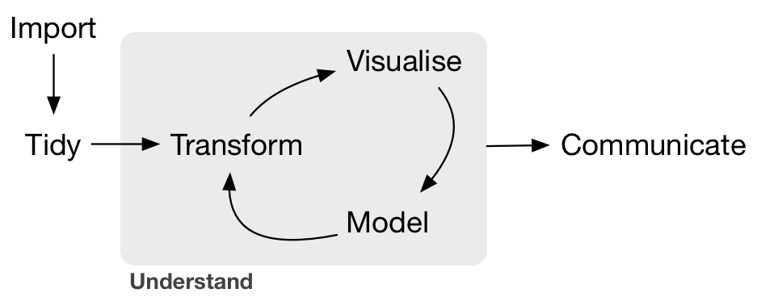
What is Data Science?
--Grolemund & Wickham, R for Data Science, O'Reilly 2016

Slide 7
Essentially a programming course…
On the screen

Slide 8
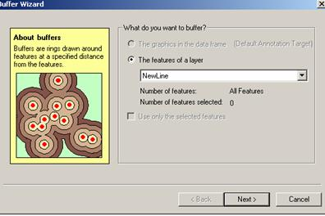
Why Code when you can Click?
Graphical User Interfaces are useful, especially when you are learning...

Slide 9
Reproducible Research
The ability to reproduce results from an experiment or analysis conducted by another*
Developed from literate programming:
Logic of the analysis is represented in output
Combines computer code with narrative
Literate Programming (1992) D.E. Knuth

Slide 10
Learning a programming language can help you learn how to think logically.
A man who does not know foreign language is ignorant of his own.
-- Johann Wolfgang von Goethe (1749 - 1832)

Slide 11
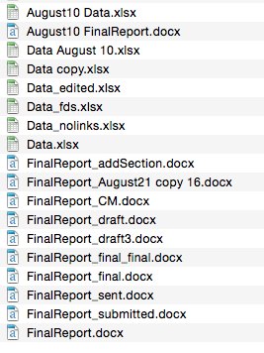
Typical GUI Workflow
Data 1:
Field Data
Excel
Stata
Graphics
Tables
Summaries
Word
Data 2:
Geotif
ArcGIS
Advisor:
I’ve updated the field data with a few more locations, please re-run that analysis…
New satellite data are available, can you update that figure?

Slide 12
Organized and repeatable workflow (and some example commands)
Scripts
Graphics
Tables
Summaries
‘Raw’ data
Gather
Clean
Prepare
Analysis
‘Raw’ data
Websites
Presentations
Manuscripts
‘Raw’ data
GDAL
GRASS GIS
dplyr
Statistics
Models
BUGS/JAGS
File.download
ROpenSci APIs
xtable
knitr/sweave
rmarkdown
Advisor:
I’ve updated the field data with a few more locations, please re-run that analysis…
New satellite data are available, can you update that figure?
Sure, I can do that
this afternoon…
Adapted from Gandrud (2014) Reproducible Research with R and RStudio.

Slide 13
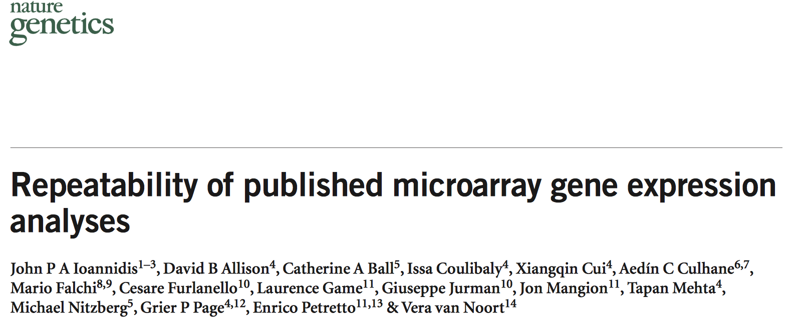
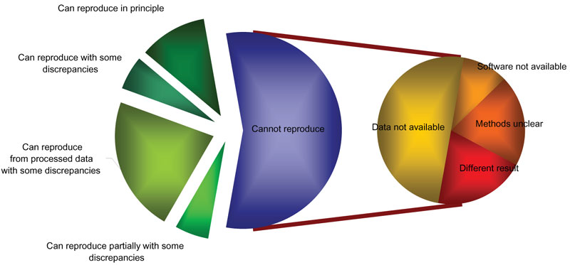
Reproducible Research
Repeatability of published microarray gene expression Analyses. Nature Genetics 41(2):149
18 articles:
2 reproducible
6 partially
10 could not be reproduced!

Slide 14
Programming gives you access to more computer power.
The computer is incredibly fast, accurate, and stupid. Man is unbelievably slow, inaccurate, and brilliant. The marriage of the two is a force beyond calculation. -- Leo Cherne

Slide 15
Organized and repeatable workflow (and some example commands)
Scripts
Graphics
Tables
Summaries
‘Raw’ data
Gather
Clean
Prepare
Analysis
‘Raw’ data
Websites
Presentations
Manuscripts
‘Raw’ data
Advisor:
I want you to take he analysis you developed for Buffalo and run it globally
Sure, I can do that
this afternoon…
Adapted from Gandrud (2014) Reproducible Research with R and RStudio.

Slide 16
From Graphical User Interface (GUI)
to scripting/programming
Write Code
Productivity
Point-and-click
My goal in
this course
Time

Slide 17
Typical software use - GEO
Software
ArcGIS 94%
Python 29%
R 29%
SPSS 29%
Google Earth Engine 24%
Erdas Imagine 24%
Scripting
Yes 71%
No 29%
Used R?
No 52%

Slide 18
The R Project for Statistical Computing
Free and Open source
Data manipulation
Data analysis tools
Great graphics
Programming language
6,000⁺ free, community-contributed packages
A supportive and increasing user community
R is a dialect of the S language developed at Bell Laboratories (formerly AT&T) by John Chambers et. al. (same group developed C and UNIX©)

Slide 19
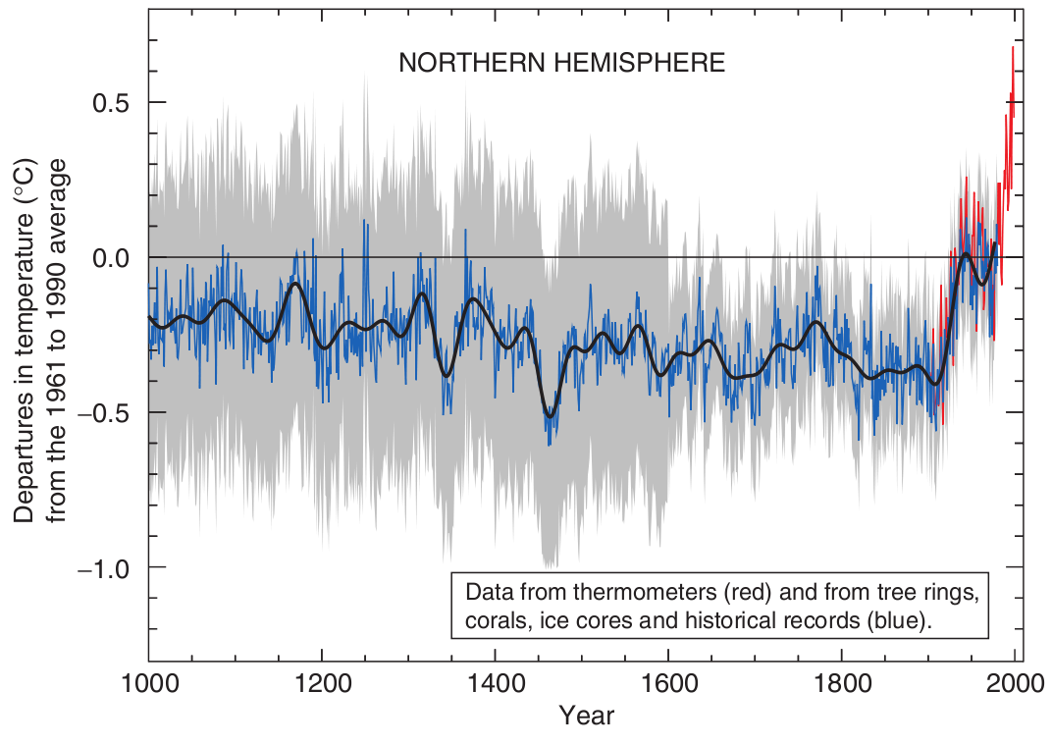
Reproducible, Portable, & Transparent
. . . all the code and data used to recreate the Mann’s original analysis has been made available to the public [...] Since the analysis is in R, anyone can replicate the results and examine the methods.
(Matthew Pocernich, R news 6/4, 10/31/06)‏
http://www.cgd.ucar.edu/ccr/ammann/millennium/refs/WahlAmmann_ClimChange2006.html

Slide 20
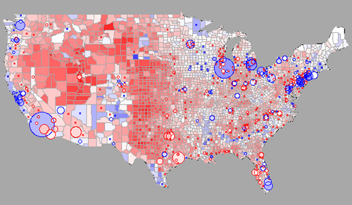
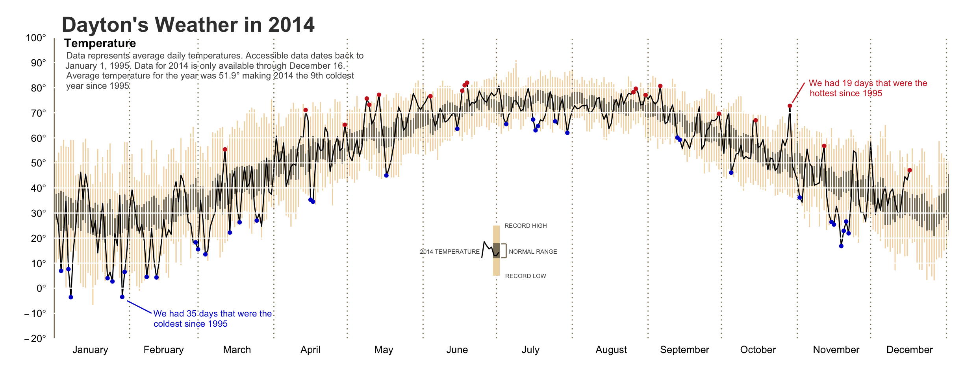
R Graphics
If you can imagine it…
http://blog.revolutionanalytics.com/2009/01/r-graph-gallery.html
http://rpubs.com/bradleyboehmke/weather_graphic

Slide 21
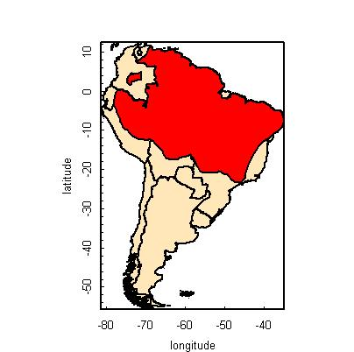
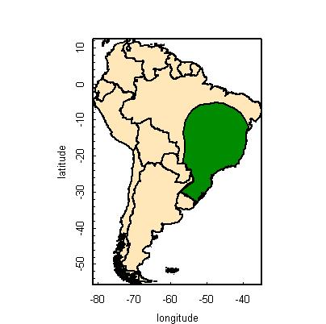
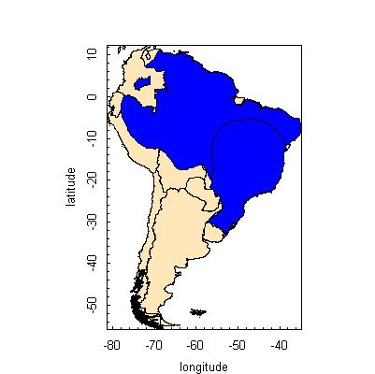
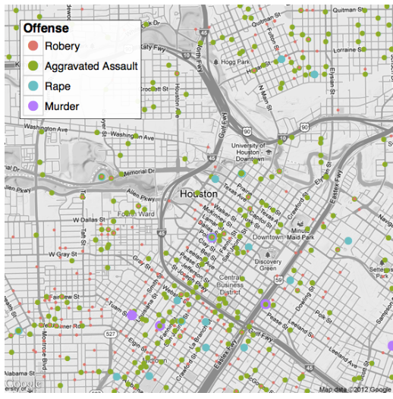
Spatial data in R
Packages: sp, maptools, rgeos, raster, ggmap
Examples:
species range overlays
Basemaps with ggmap
http://www.nceas.ucsb.edu/
+
=
http://journal.r-project.org/archive/2013-1/kahle-wickham.pdf

Slide 22
Parallel Processing
For BIG jobs:
multi-core processors / high performance computing with foreach.
Output
Data
Script
Processor #1
Processor #2
Processor #3

Slide 23
Strengths & Limitations
Just-in-time compilation:
Slower than compiled languages (-)
Faster to compose (+)
Many available packages (+)
Most operations conducted in RAM
RAM can be limiting and/or expensive (-)
“Error: cannot allocate vector of size X Mb”
Various packages and clever programming can overcome this… (+)
Free like beer and speech! (+)

Slide 24
R Interface
But there are
other options...

Slide 25
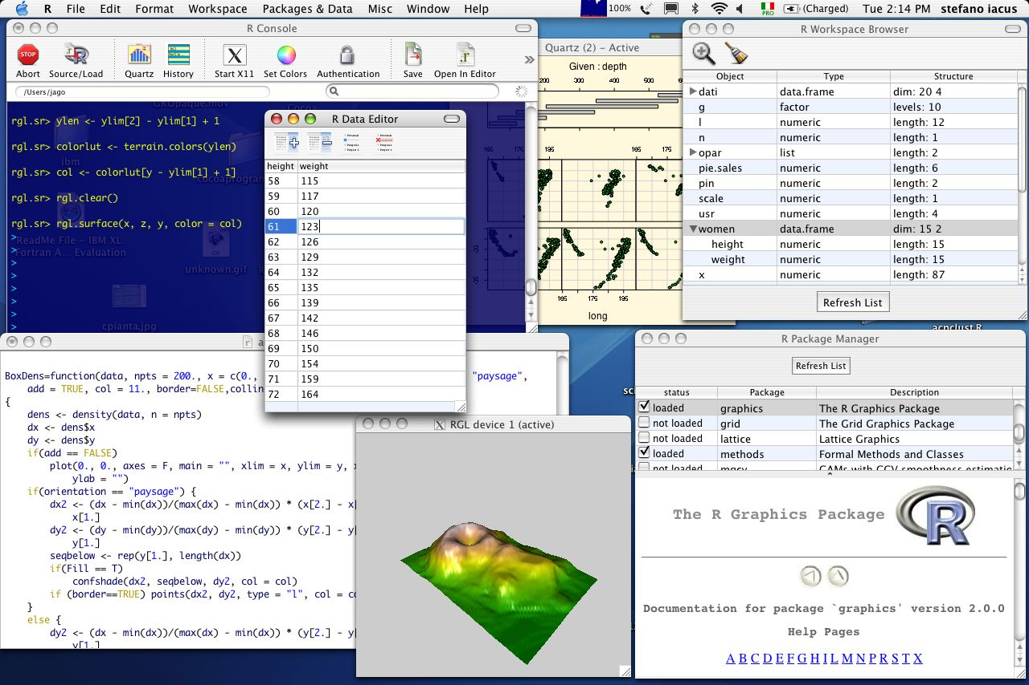
R in Mac

Slide 26
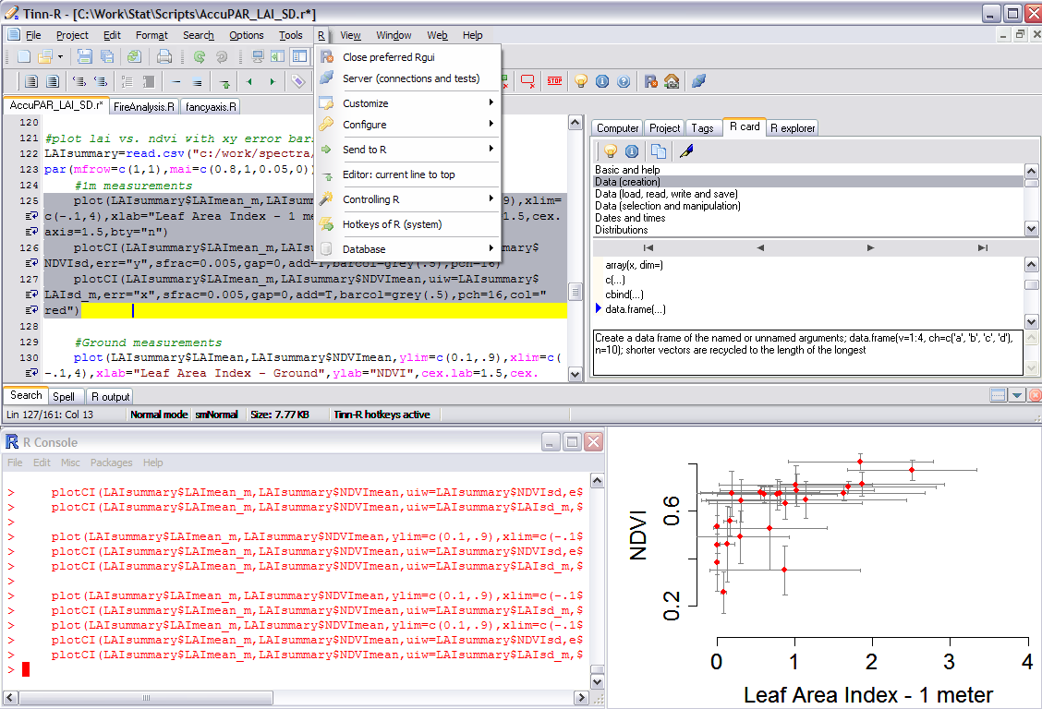
R in Windows

Slide 27

Mac, Windows, Linux, and over the web…

Slide 28
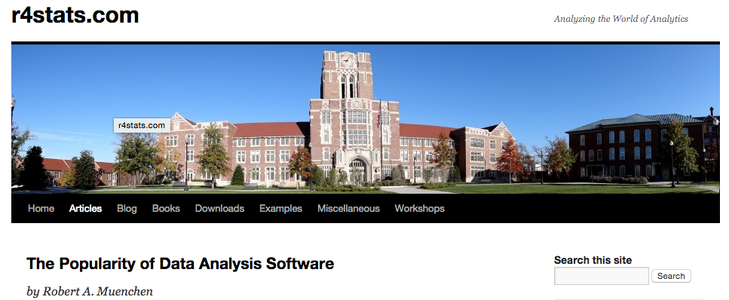
Who uses R?
http://r4stats.com/articles/popularity/

Slide 29
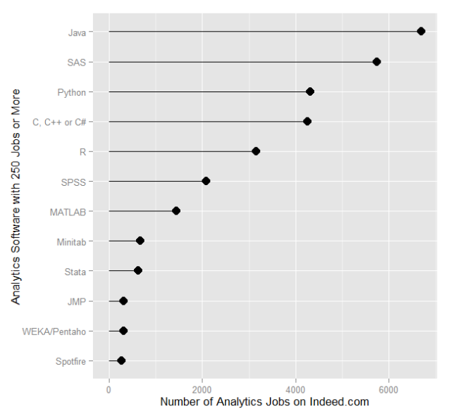
“Analytics” Jobs on indeed.com
Feb 2014: http://r4stats.com/articles/popularity/

Slide 30
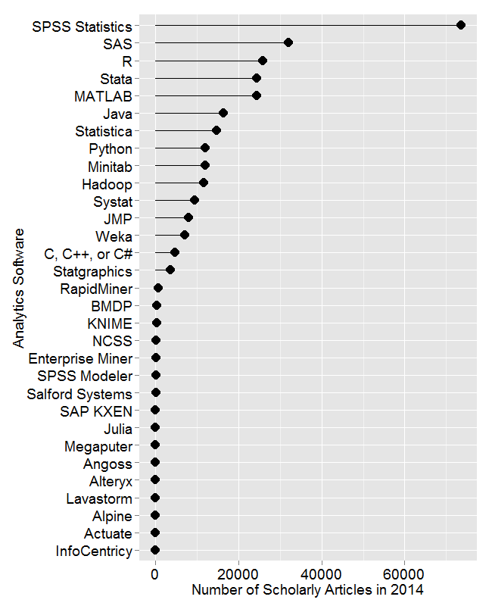
Scholarly articles by software package
Number of scholarly articles found in the most recent complete year (2014) for each software package used as a topic or tool of analysis. For methods see here.
http://r4stats.com/articles/popularity/

Slide 31
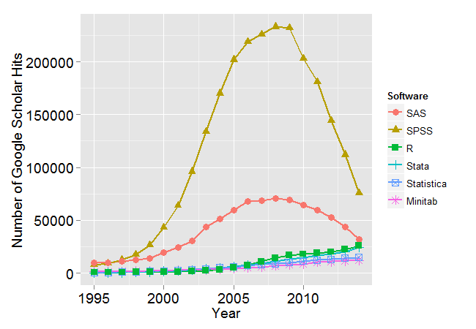
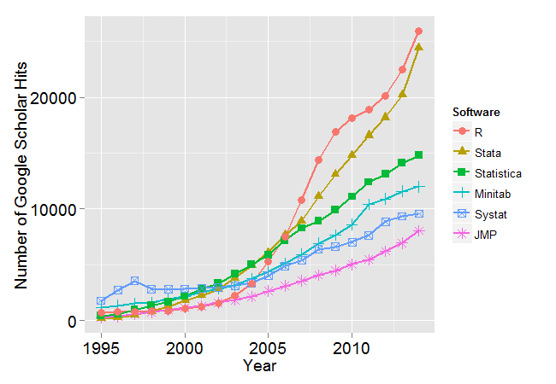
Change in scholarly articles
The number of scholarly articles found in each year by Google Scholar. Only the top six “classic” statistics packages are shown.
The number of scholarly articles found in each year by Google Scholar (excluding SAS and SPSS).
http://r4stats.com/articles/popularity/

Slide 32
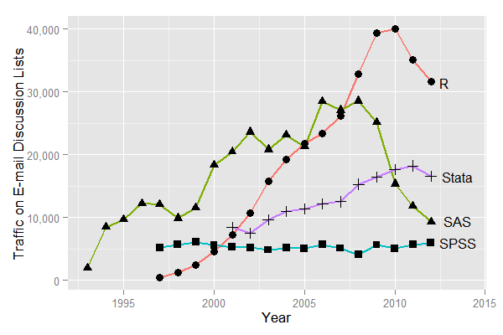
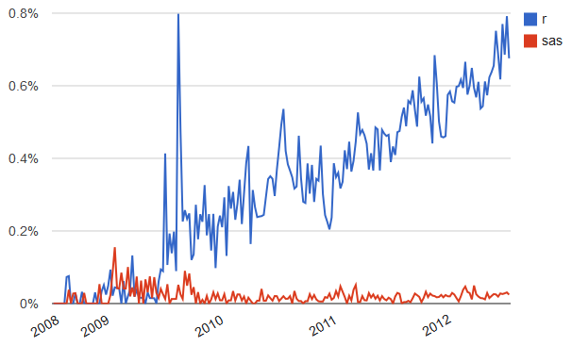
Forum/discussion activity
Sum of monthly email traffic on each software’s main listserv discussion list.
Number of R- or SAS-related posts to Stack Overflow (programming and statistical topics) by week.
http://r4stats.com/articles/popularity/

Slide 33
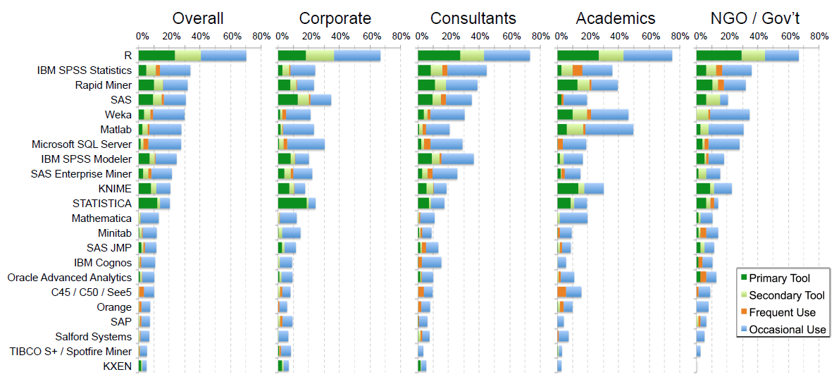
Rexer Analytics Data Miner Survey (2013)
~1.2k respondents http://r4stats.com/articles/popularity/

Slide 34
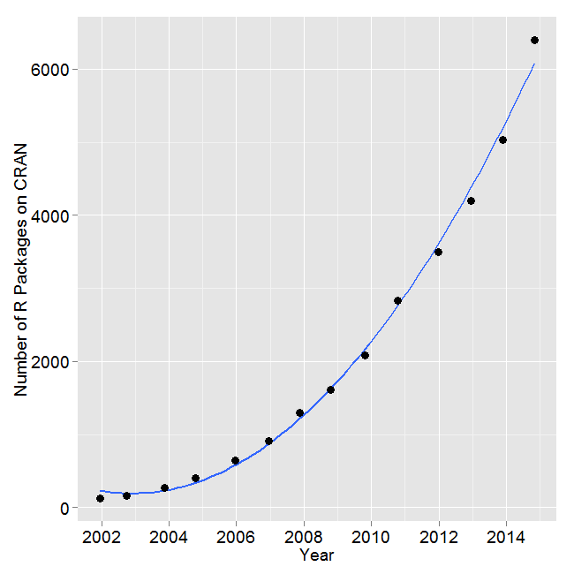
R Development
Number of R packages available on its main distribution site for the last version released in each year.
SAS v9.3: 1.2k commands
(in Base, Stat, ETS, HP Forecasting, Graph, IML, Macro, OR, QC.)
2014: R added 1.3k packages and ~27k functions.
http://r4stats.com/articles/popularity/
Over 6k packages!
Task Views organize packages by topic: http://cran.r-project.org/web/views/

Slide 35


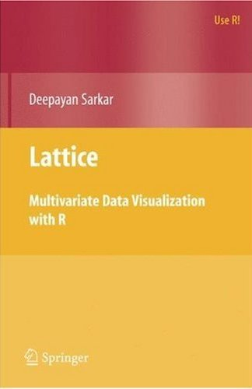




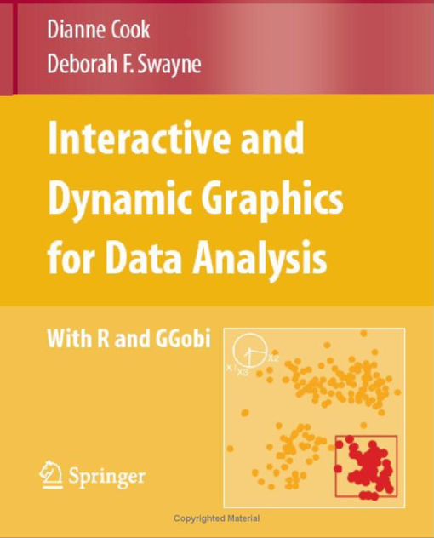




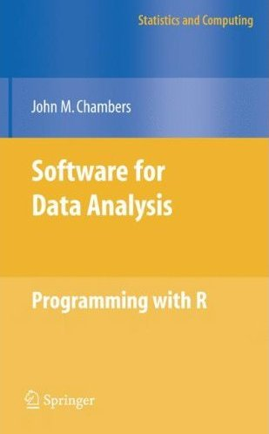




240 Books on R since 2000

Slide 36
Course Logistics
Course Participation 10% Package Presentation 10% Homeworks 30% Final Project 50%
On the screen

Slide 37
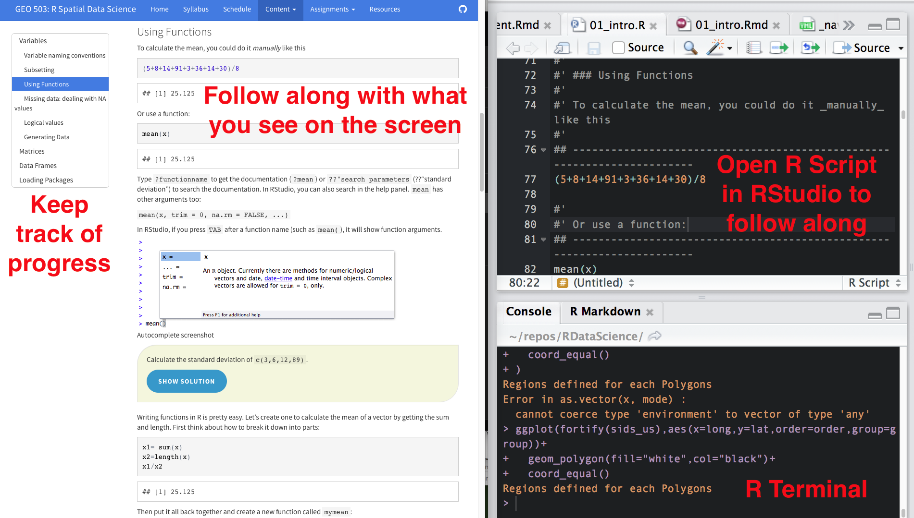
Course Participation (10%)
On the screen

Slide 38
Package Introduction (10%)
Each student will be expected to introduce a R package (or two) that is relevant to their research interests in a 5 minute presentation during a class session. The objectives are:
Learn how to find/download/install a new package and learn how to use it
Teach your peers about useful R packages
The presentation must include:
What does the package do? (1-2 slides, 1 minute)
Author introduction (1 slide, 1 minute)
Simple demonstration (2-3 slides, 3 minutes)

Slide 39
Homework (30%)
#' ## Question 1
#' Load the iris dataset by running
## ------------------------------------------------------------------------
data(iris)
#' And read about the dataset in the documentation:
## ------------------------------------------------------------------------
?iris
#'
#' > How many observations (rows) are there for the versicolor species?
#'
#' _______________________
#'
#' ## Question 2
#' Create a vector with the following values: 23, 45, 12, 89, 1, 13, 28, 18. Then multiply each element of the vector by 15.
#'
#' > What is the standard deviation of the new vector?
#'

Slide 40
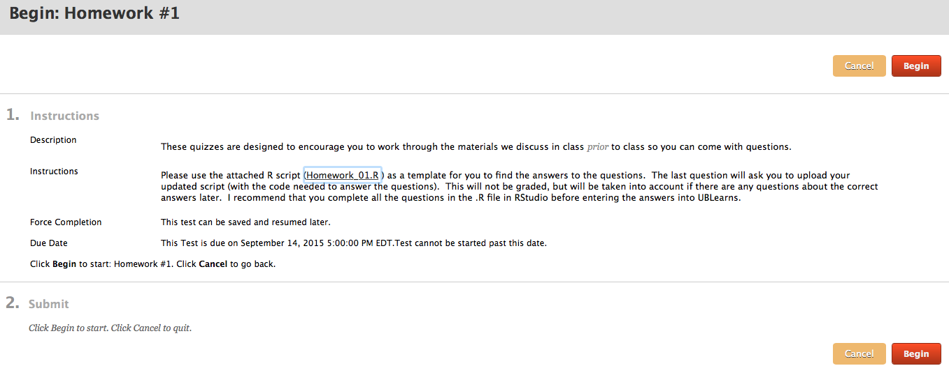
Homework submitted in UBlearns
Working collaboratively is encouraged but you are responsible for developing your own code to answer the questions:
Acceptable: “which functions did you use to answer #4?”
Unacceptable:“please email me your code for #4.”

Slide 41
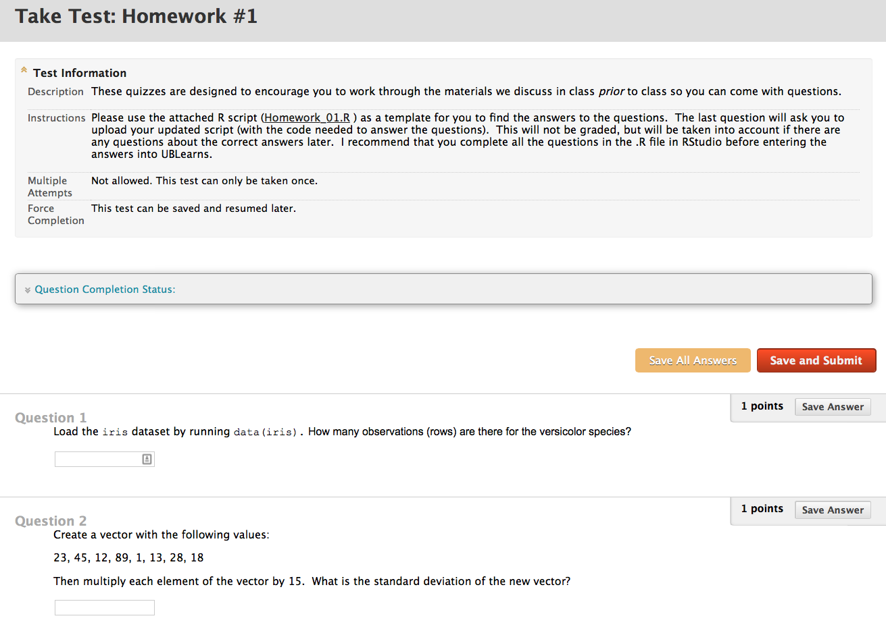
Homework format

Slide 42
Final Project – Poster / Infographic (50%)
Title (<25 words)
Introduction [~ 150 words]
Materials and methods [~ 150 words]
Results [~200 words]
Conclusions [~200 words]
References
And all code to reproduce the analysis!!

Slide 43
"It takes intelligence, even brilliance, to condense and focus information into a clear, simple presentation that will be read and remembered. Ignorance and arrogance are shown in a crowded, complicated, hard-to-read poster.” -- Mary Helen Briscoe

Slide 44
Notes:
Code: Download relevant data, Clean, integrate, and summarize, Make figures (final layout in Rmarkdown or another program)

Slide 46
Tornado Tracks
https://www.flickr.com/photos/idvsolutions/7157010997/sizes/l/in/photostream/

Slide 47










A little about me…
Ecology
Earth Science
Sustainable Development
Ecology
Geography
Climate Change Mitigation
Notes:
Shiang-yu Jiang

Slide 48
And who are you?
Name
Where are you from (state and/or country)?
Department/Degree (e.g. MS GIS)
Research Interests
Motivation for taking this course (what do you want to learn?)
~1 minute each!

Slide 49
Before next class
No class next week (Labor Day)
Install RStudio on your laptop from https://www.rstudio.com
Read and work through the Introduction to R (link on website)

